Slide 1
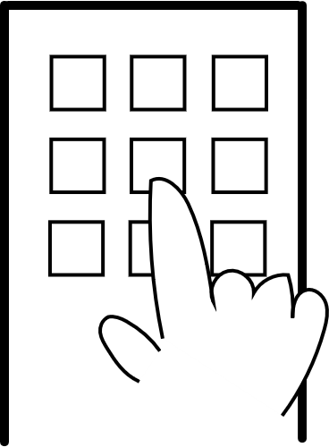
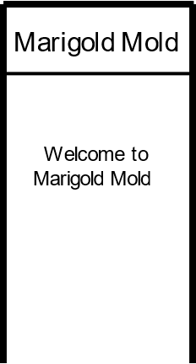
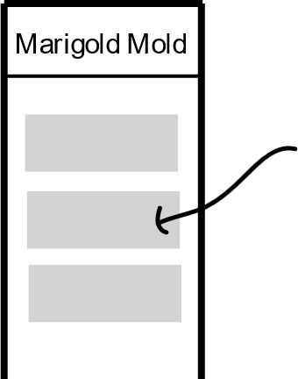
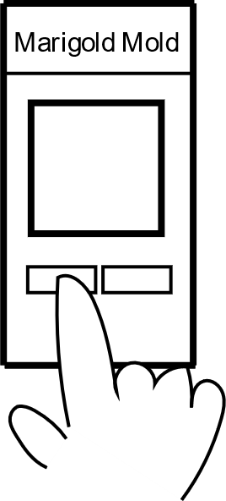
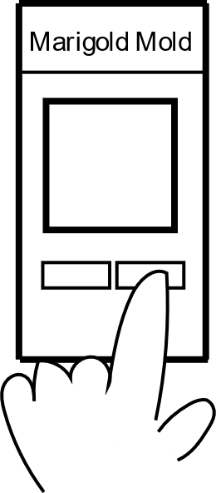
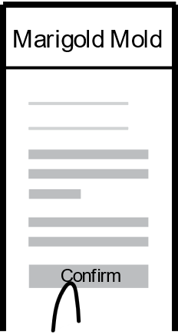
UX Design Storyboard
Scenario: Use Marigold Mold which is an accessible and easy to use app and enables users to choose and order their favorite flower or plant with necessary information about their maintanance.
Mary opens the app
Mary is welcomed
Mary choose her favorite
plants or flowers
Mary applies for the
Maintenance plant file
Mary can also apply for
An expert to put the plants in the ground
Mary confirm the orders

